Slide 1


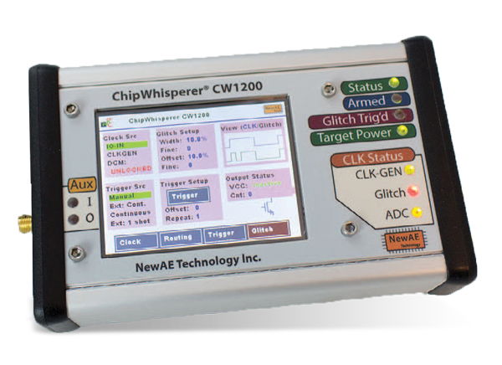
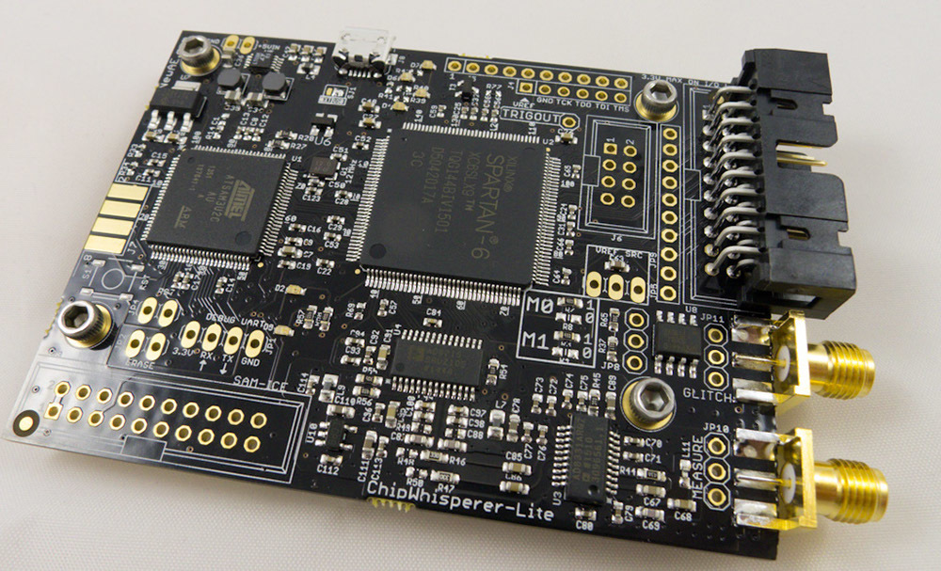
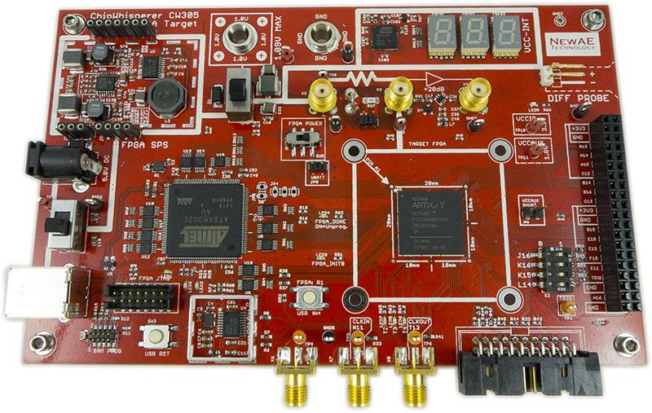
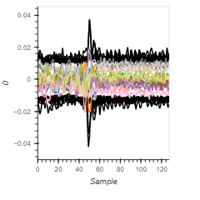
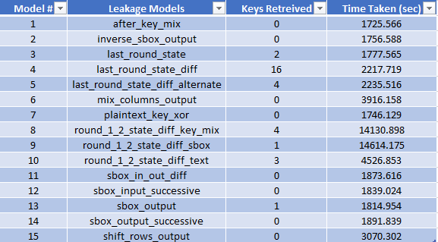
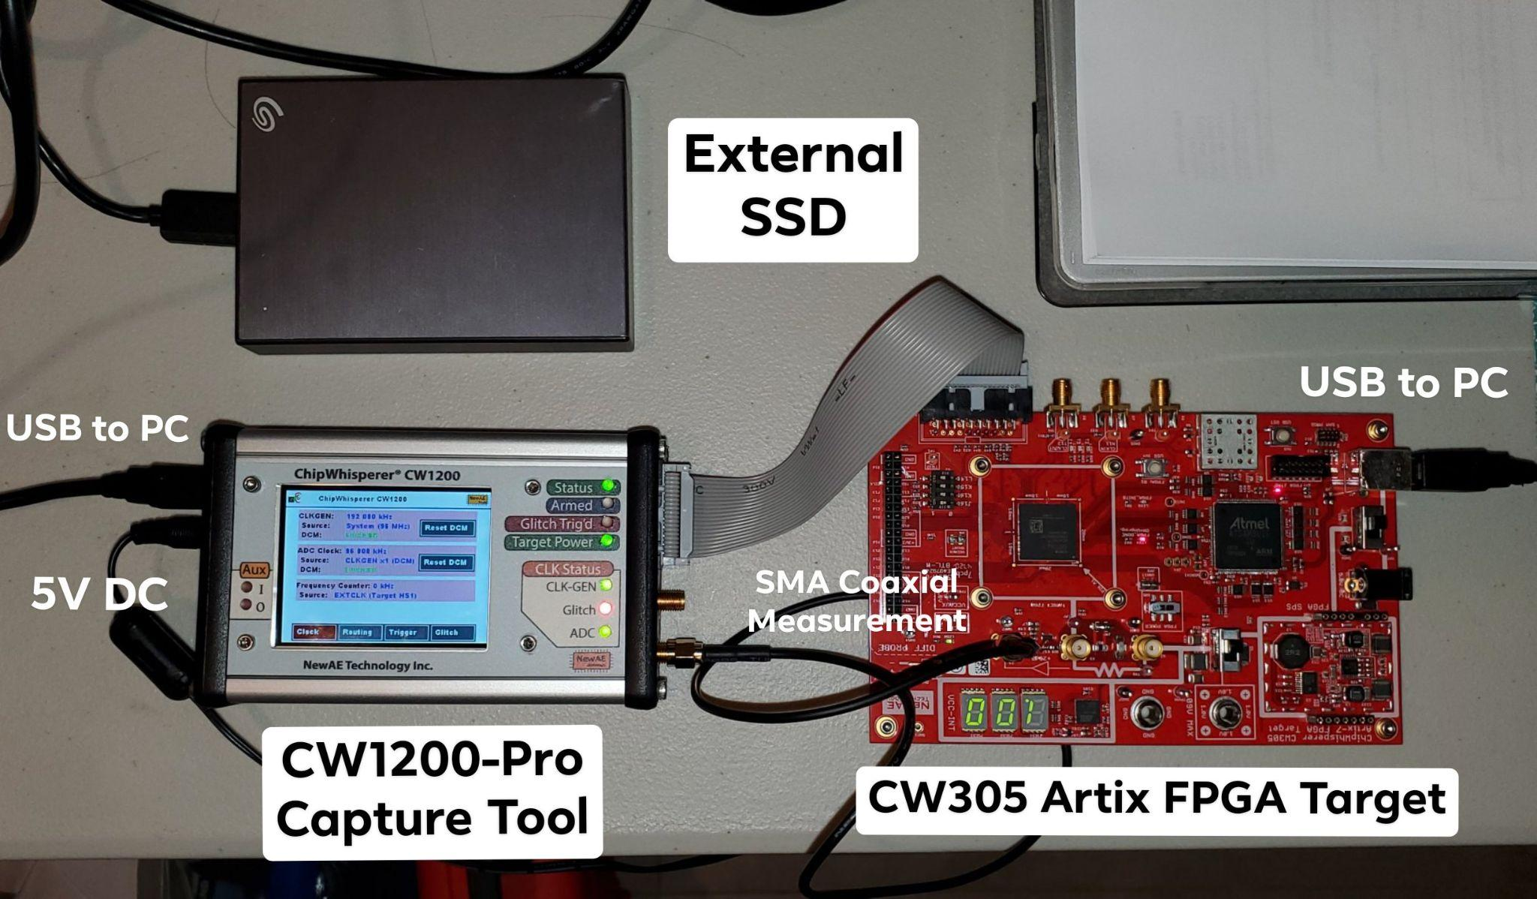
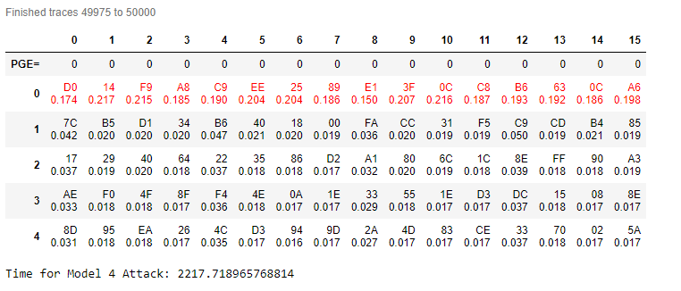
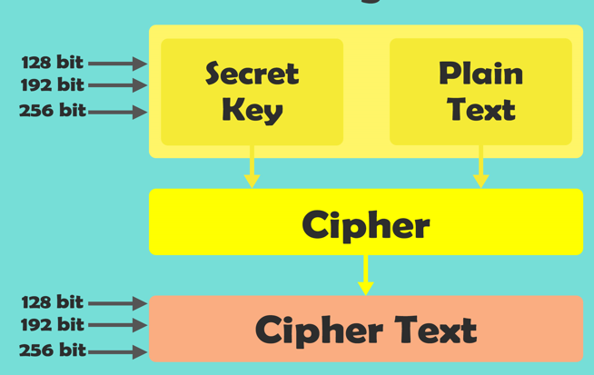
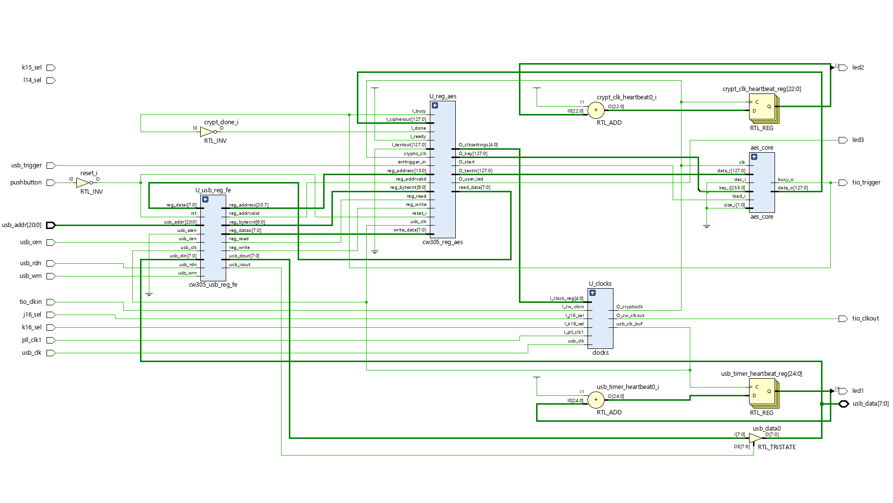
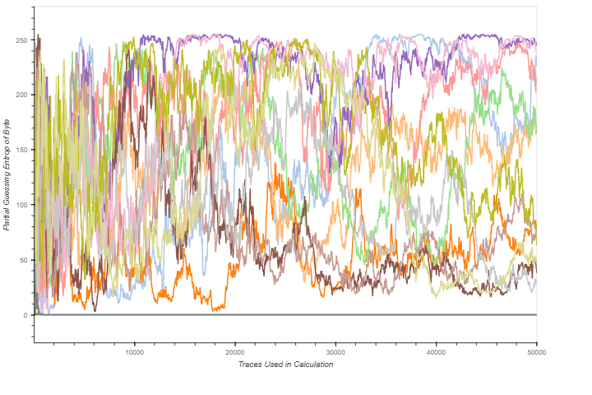
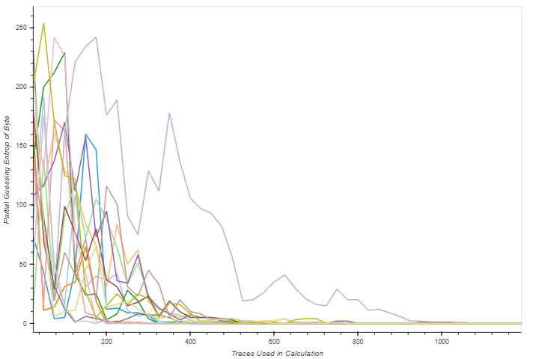
Analysis of Correlation Power Analysis Attacks in
Context to the Internet of Things
Andy Nguyen, Aaron Nguyen, Computer Engineering Program
Adviser: Dr. Jaya Dofe
Background
Experimental Setup
Results
Internet of Things (IoT) — emerging technology paradigm of various types of machines and devices able to communicate with each other via the Internet
IoT bring extraordinary possibilities for improvements in various domains like smart cities and grids, healthcare, wearable devices, robotic systems and many other numerous systems
Challenge to balance IoT device design to be cost effective and secure
Advancing technology requires IoT security to be more capable of addressing growing malicious attacks
Widespread availability of IoT devices, make them vulnerable to especially physical attacks, also known as side channel attacks, aimed at reading physical implementations
Advanced Encryption Standard (AES) is used in industry and military encryption for secure communication and is used in our research as a case study subject
Capture Boards and Target Board
Side-channel Attacks are performed using the CW1200 and the CWLITE capture boards
Target simulation is performed using the CW305
The CW305 can implement countermeasure defenses using hardware besides software by using an FPGA
Attack Information
The time each leakage model took to analyze the 50k power traces and how many keys were retrieved were recorded
Last_state_diff was the most effective leakage model for this hardware AES implementation, being the only one to derive the key in 50k power traces
Last_state_diff attacks the hamming weight between round 9 and round 10 of the AES operations
CW1200
CWLite
CW305
Power vs Time of 50k Traces
Analysis of 15 Leakage Models for 50k Traces
Advanced Encryption Standard
AES is a symmetric block cipher that encrypt (encipher) and decrypt (decipher) information
Although AES is a secure algorithm, the hardware implementation of AES can leak secret through the analysis of its hardware’s physical properties called a side-channel attack.
Complete Experimental Setup
Jupyter and Vivado
The boards are programmed using Jupyter and bitstreams are created using the Vivado platform
Leakage Models
There are several points in the AES operation where leaked data can be exploited
Chipwhisperer provides 15 CPA leakage models which can be used to derive the secret key from AES implementations
50k power traces from a standard hardware AES implementation are captured and then analyzed using the 15 leakage models
Last_state_diff Leakage Model
Plaintext
Round Transformations
Partial Guessing Entropy Comparison
In PGE vs Traces graph, PGE of 0 indicates the key is correctly retrieved
A comparison is shown between unsuccessful key retrieval and a successful key retrieval
Summary
Last_state_diff leakage model retrieving the secret key successfully for the given hardware implementation does not mean it will be successful for other hardware implementations.
Same with the other leakage models, some that were not successful in retrieving the secret key may find success in retrieving the key from other hardware implementations
Further testing will be done on other hardware AES implementations once we fully port to the Chipwhisperer environment
Round 1
SubBytes
Round 2
ShiftRows
MixColumns
AES Encryption
Round N_{r}
AddRoundKey
Ciphertext
Encryption Structure of AES Algorithm
PGE vs Traces Graph (Key Not Found)
PGE vs Traces Graph (Key Found)
Scope of the Work
RTL Schematic of AES
Using side-channel technology, namely NewAE ChipWhisperer, simulation of a real-world situation to replicate an actual attack
Analysis of AES baseline design against power analysis attack
Investigation of a lightweight masking countermeasure to counteract the power-based side-channel analysis
Such countermeasures are crucial for preventing harmful attacks in the advancing world we live in today

